Slide 1
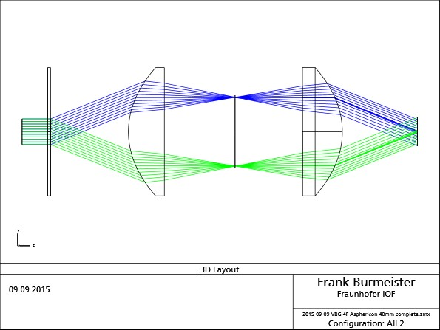
f₁ = 40 mm
C50-40HPX
f₂ = 40 mm
A50-40HPX
P = 2,15 µm
EPD = 10 mm

Slide 2
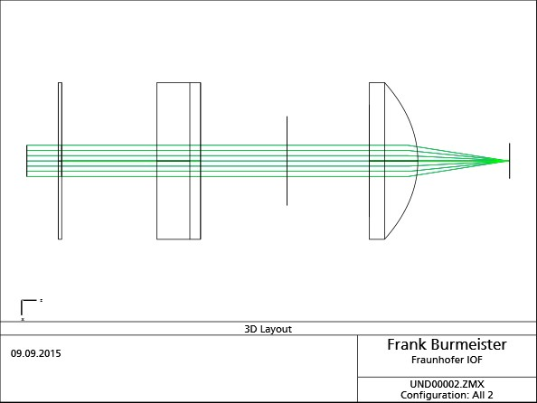
f₁ = 40 mm
C50-40HPX
f₂ = 40 mm
A50-40HPX
P = 2,15 µm
EPD = 10 mm

Slide 3
